Slide 1

Elements & Attributes

Slide 2
Agenda
Formatting tags
List
Table
Form & Input tags
Images
Styles
Placeholder
Inline & block elements
Id vs class attributes

Slide 3

Formatting Tags

Slide 4
HTML Formatting is a process of formatting text for better look and feel.
Formatting elements were designed to display special types of text:
<b> - Bold text
<strong> - Important text
<i> - Italic text
<em> - Emphasized text
<mark> - Marked text
<small> - Smaller text
<del> - Deleted text
<ins> - Inserted text
<sub> - Subscript text
<sup> - Superscript text

Slide 5
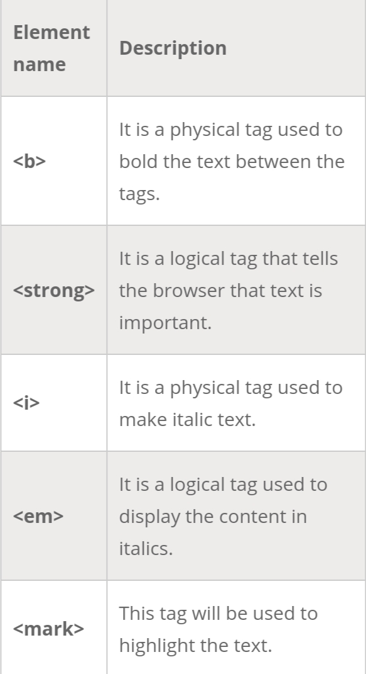
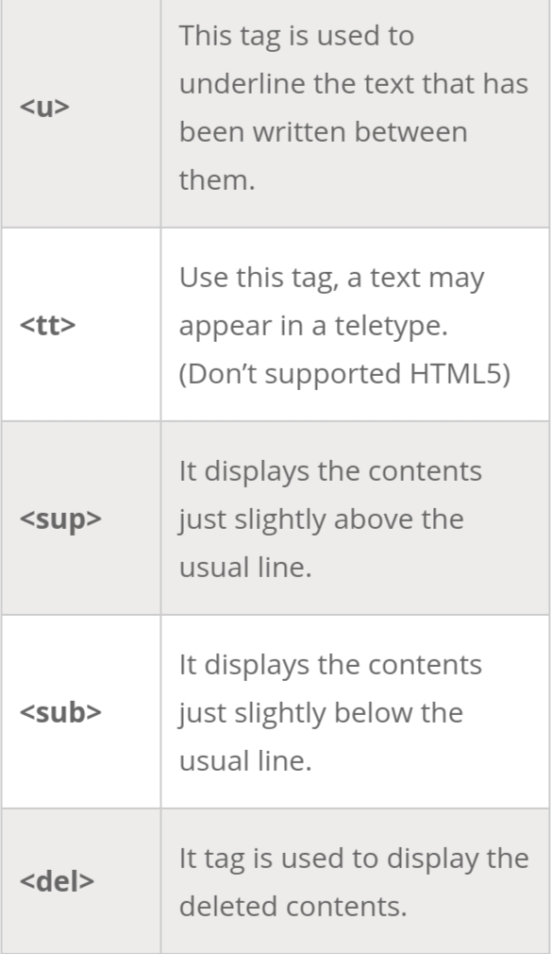

Slide 6
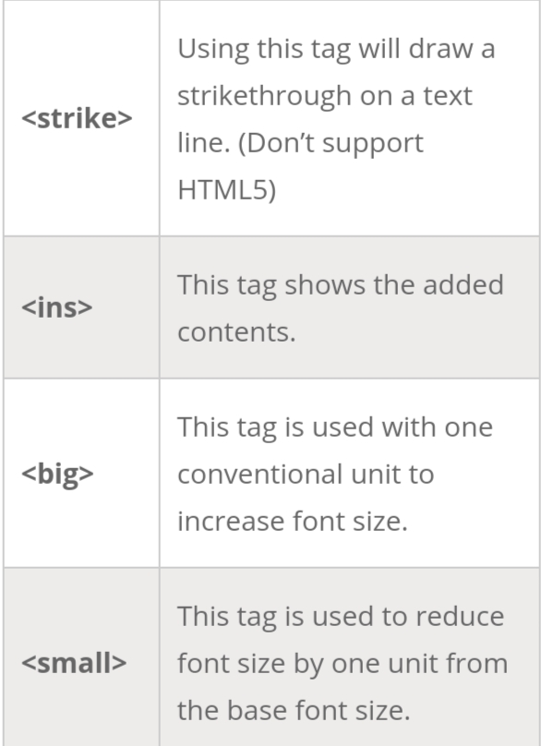

Slide 7

List

Slide 8
HTML Lists are used to specify lists of information.
All lists may contain one or more list elements.
There are three different types of HTML lists:
Ordered List or Numbered List (ol)
Unordered List or Bulleted List (ul)
Description List or Definition List (dl)

Slide 9
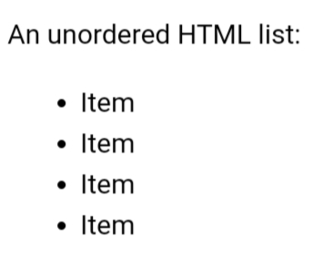
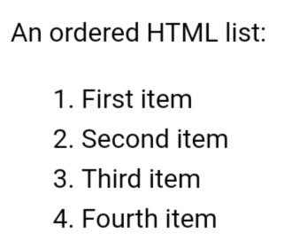
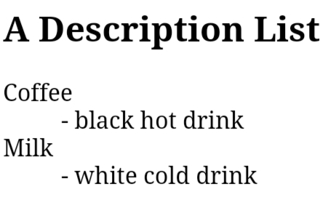

Slide 10
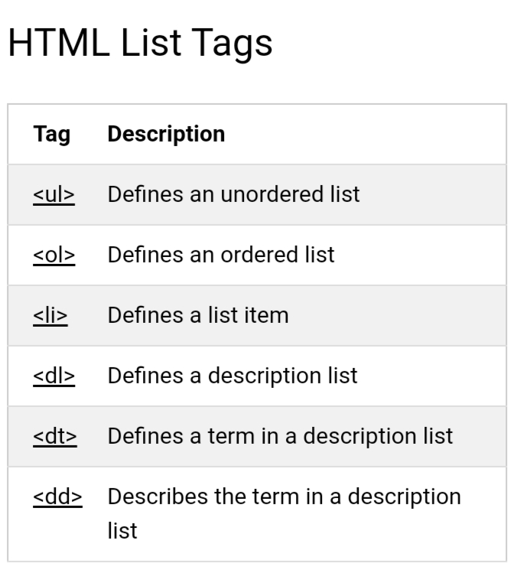

Slide 11

Table

Slide 12

HTML tables allow web developers to arrange data into rows and columns.

Slide 13
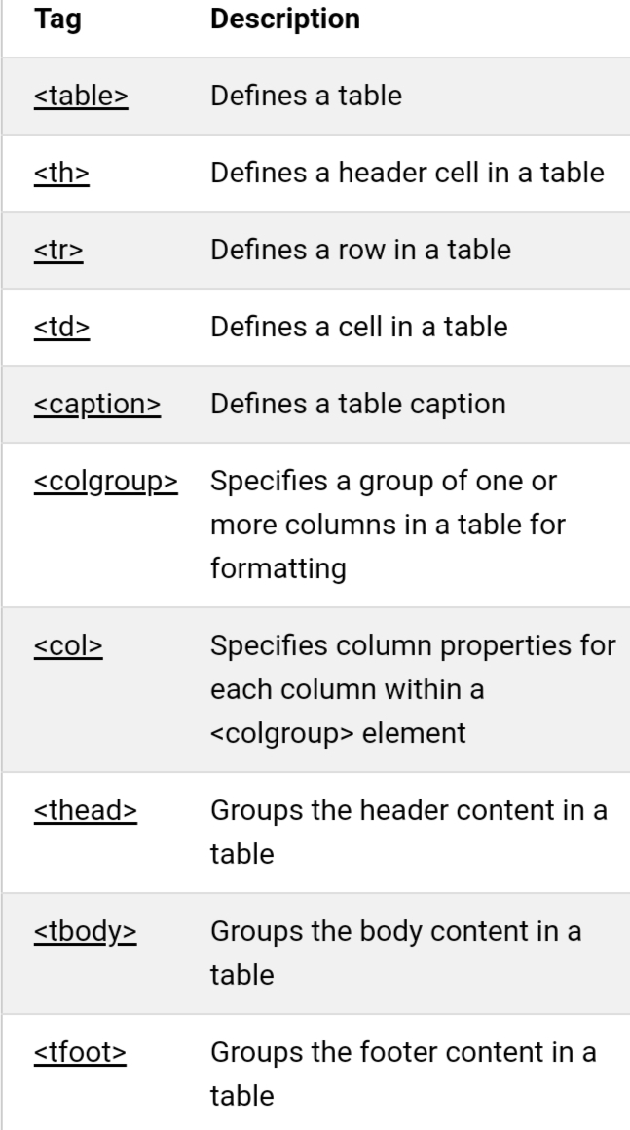

Slide 14

Form & Input tags

Slide 15
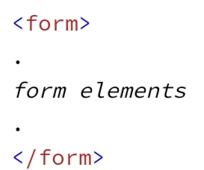
An HTML form is used to collect user input. The user input is most often sent to a server for processing.
The <form> Element:The HTML <form> element is used to create an HTML form for user input:
The <input> Element:The HTML <input> element is the most used form element.
An <input> element can be displayed in many ways, depending on the type attribute.

Slide 16
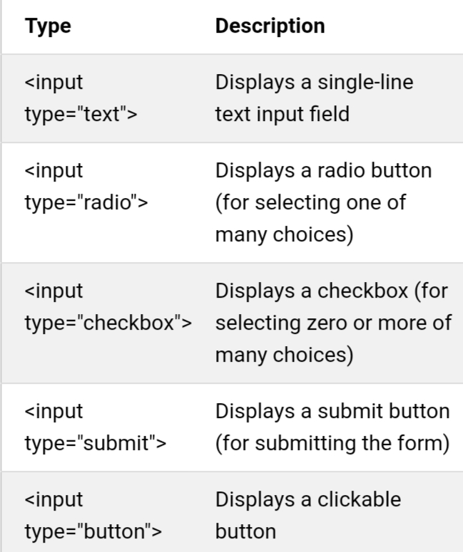

Slide 17
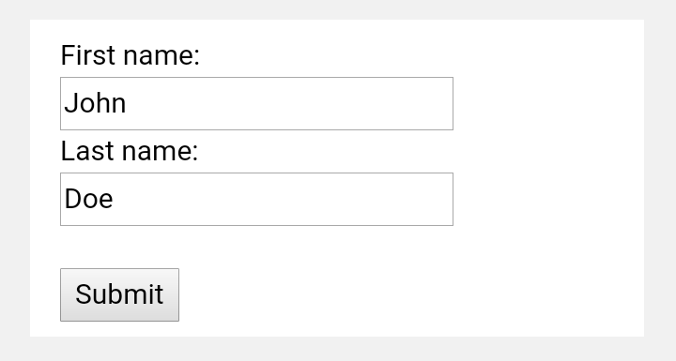

Slide 18

Images

Slide 19
The <img> tag has two required attributes:
src - Specifies the path to the image
alt - Specifies an alternate text for the image
Syntax:. <img src="url" alt="alternatetext">
<img src="img_chania.jpg" alt="Flowers in Chania">

Slide 20
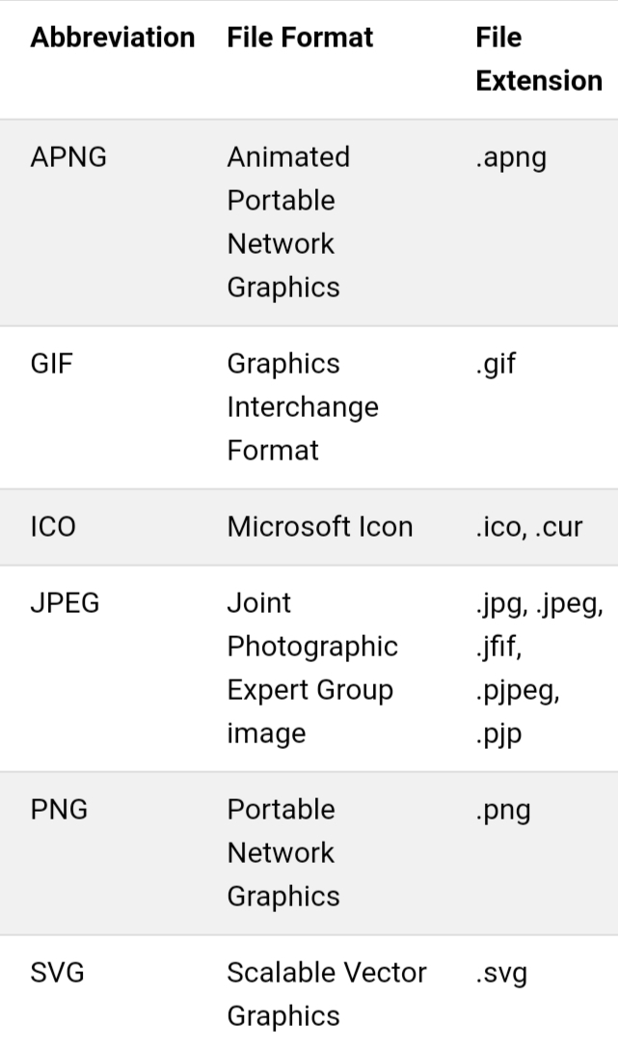
Common Image Formats

Slide 21

Styles

Slide 22
Use the style attribute for styling HTML elements
Use background-color for background color
Use color for text colors
Use font-family for text fonts
Use font-size for text sizes
Use text-align for text alignment

Slide 23
The HTML Style Attribute syntax:. <tagname style="property:value;">
The property is a CSS property.
The value is a CSS value.

Slide 24
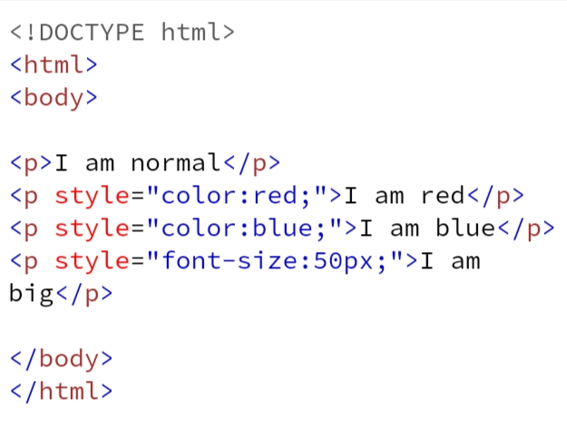
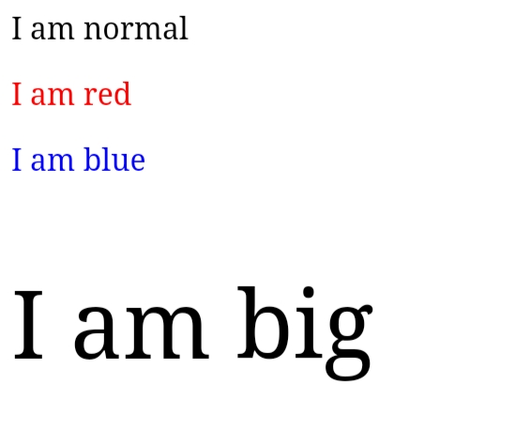

Slide 25

Placeholder

Slide 26
HTML <input> placeholder Attribute
placeholder attribute specifies a short hint that describes the expected value of an input field (e.g. a sample value or a short description of the expected format).
The short hint is displayed in the input field before the user enters a value.
Note: The placeholder attribute works with the following input types: text, search, url, tel, email, and password.

Slide 27
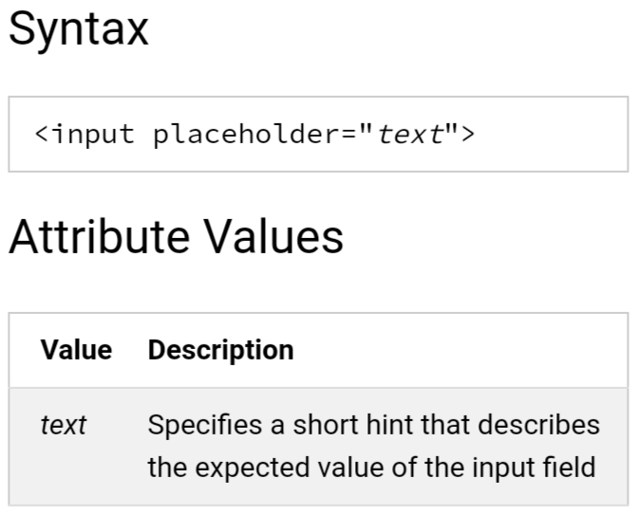

Slide 28
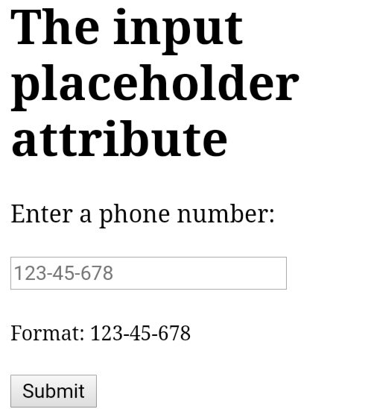

Slide 29

In line & block elements

Slide 30
Every HTML element has a default display value, depending on what type of element it is.
There are two display values:
block and
inline

Slide 31
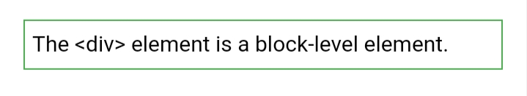
Block-level Elements
A block-level element always starts on a new line.
A block-level element always takes up the full width available (stretches out to the left and right as far as it can).
A block level element has a top and a bottom margin, whereas an inline element does not

Slide 32
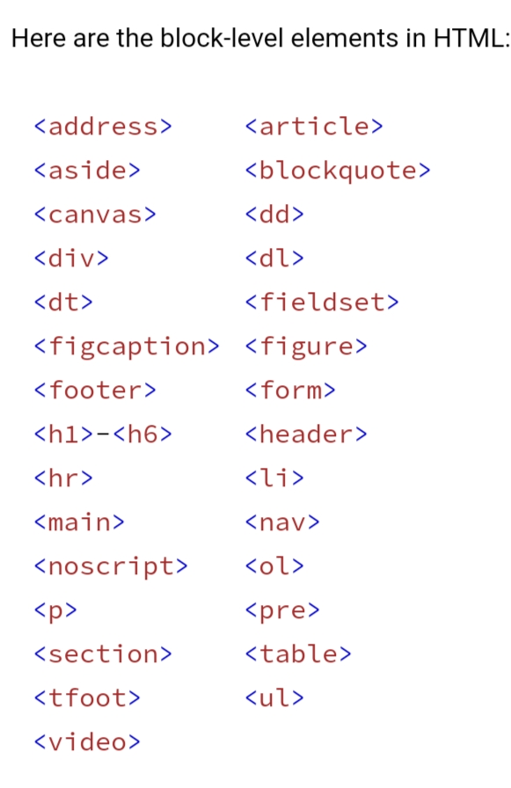

Slide 33

Inline Elements
An inline element does not start on a new line.
An inline element only takes up as much width as necessary.

Slide 34
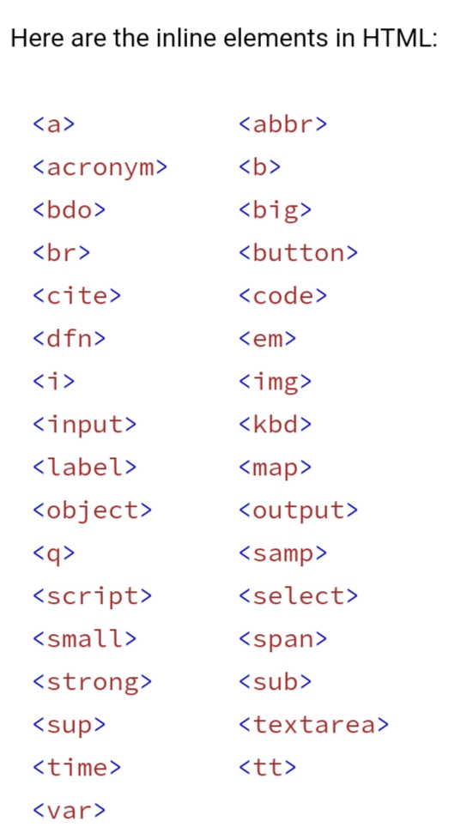

Slide 35

Id vs attributes

Slide 36
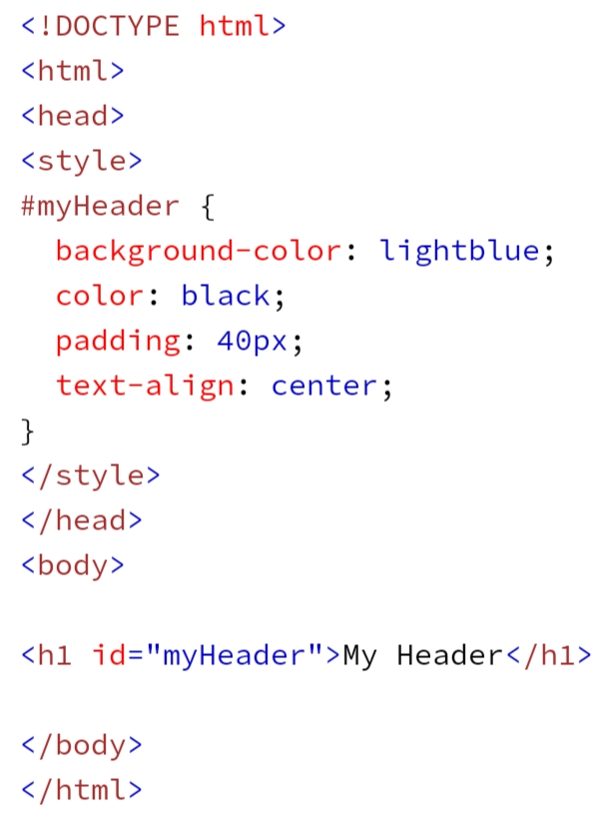
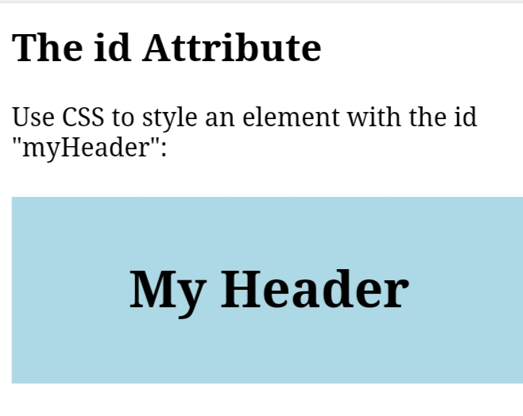

Slide 37
ID
The ID of a form Element nothing to do just an identification and nothing to do with the data contained within the element.
The IDs are attached in writing and using in Javascript and CSS.
Referened with JS method getElementByID()

Slide 38
Difference Between Class and ID
A class name can be used by multiple HTML elements, while an id name must only be used by one HTML element within the page:

Slide 39
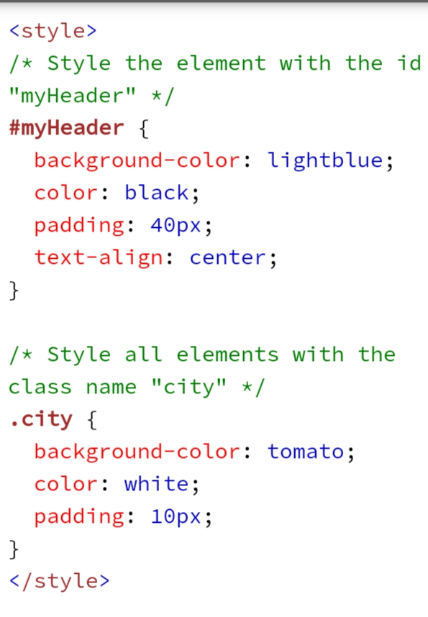
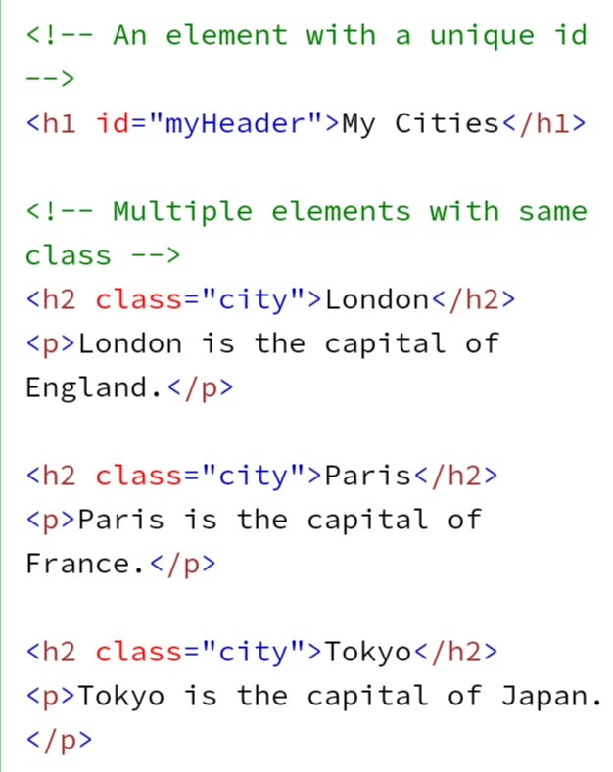

Slide 40
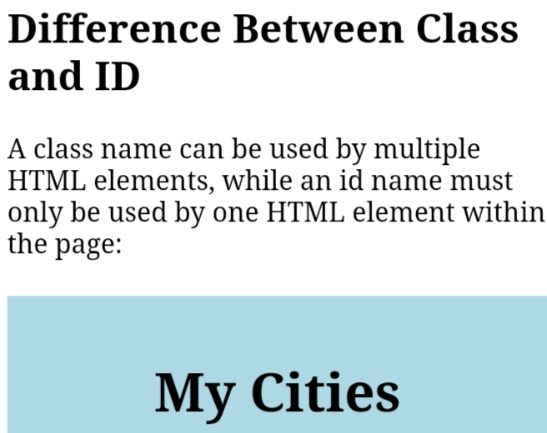
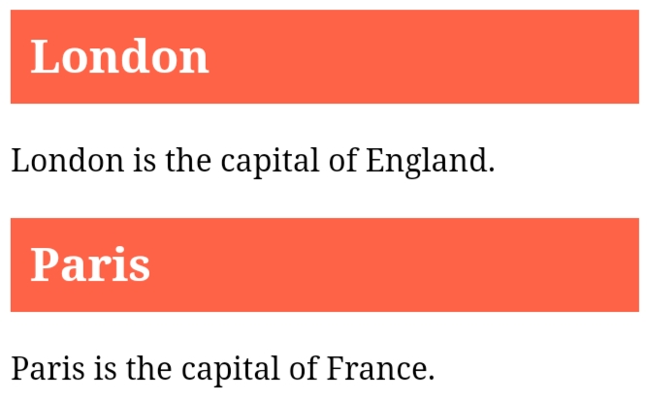
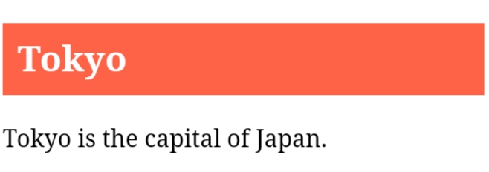

Slide 41
Attributes
The NAME attribute is used in the HTTP request sent by browser to the server as a variable name and it is associated with the data contained in the value attribute.
We Cannot be referenced in CSS or any URL
Referenced with JS method getElementByName()

Slide 42


